Slide 1
M13

Slide 2

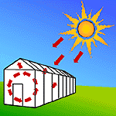
Greenhouse effect and global warming :
Greenhouses are small glass houses constructed to grow plants
particularly during cold winters.
The glass panel all around lets the sunlight enter but does not
allow heat to escape.
What is a greenhouse?

Slide 3
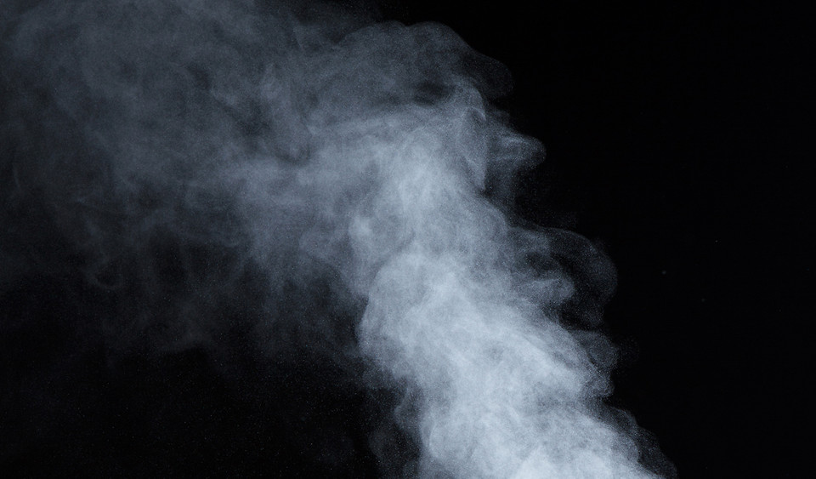
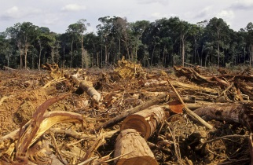
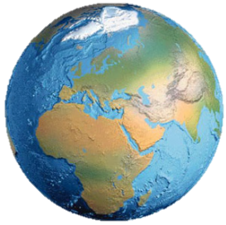
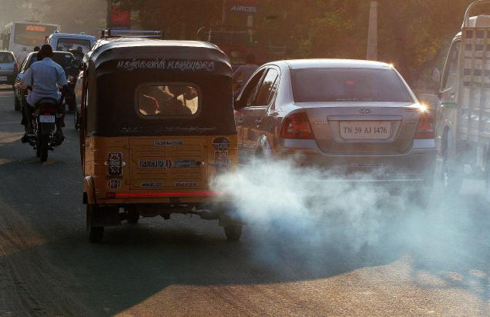
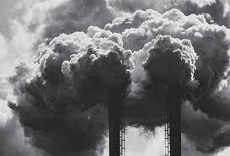
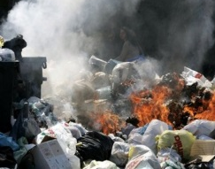
Earth receives energy from the sun.
The earth surface absorb solar energy
But some of the infrared radiations emitted by the earth is absorbed by CO₂ and CH₄ in the atmosphere.
Also the decreasing vegetation and deforestation is leading to less CO₂ utilization in photosynthesis.
Similarly,
And it is sent back to the earth as heat energy
This causes a warming effect known as Green House Effect.
With the increased industrialization, burning of fuels in homes and rising population more CO₂ is released.
So it leads to more heat getting trapped in the earth’s atmosphere.
SUN
This leads to increase in warming of the earth leading to Global warming.
This helps to maintain the temperature of the earth.
and releases back to the atmosphere as infrared radiation.
CH₄
CO₂
CH₄
CO₂
CH₄
CO₂
CO₂

Slide 4

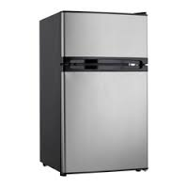

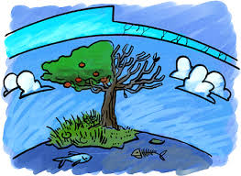
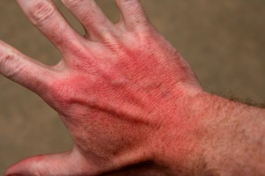


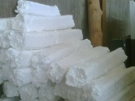
Ozone layer
There they break down into chlorine atoms which in turn breakdown ozone (O₃) into oxygen (O₂) and O.
The reduced ozone cannot prevent the entry of harmful UV-B rays.
UV-B rays cause sunburn, genetic disorders, skin cancers and reduced productivity of forests and sea.
In the upper reaches of the atmosphere, a molecule containing three atoms of oxygen is found.
This would mean a formula of O₃ and this is called ozone.
It forms a sort of sunscreen high up in the atmosphere.
It prevents the harmful types of ultraviolet rays (UV-B) coming down from the sun.
Protects plant and animals.
SUN
CFC
Cl₂
O₃
O₂
Cl₂
O
CFC
Certain gaseous compounds such as CFCs (chlorofluorocarbons) released from refrigerators, aerosol-sprayers and packing materials styrofoam, rise into the atmosphere.
Ozone (O₃)
CFC

Slide 5
Thank You

